Slide 1
INTERNSHIP STUDIO
ETHICAL HACKING
TASK -3
DILIS DENNY

Slide 2
REPORT
DOMAIN:
http://testasp.vulnweb.com
SUBDOMAIN:
http://testasp.vulnweb.com/Search.asp
____
TESTING ENVIRONMENT :
Kali Linux Burp suite community edition 2020.12.1
____
DESCRIPTION :
Reflected cross site scripting found in our website.
____
Steps to reproduce:
Step1:Visit http://testasp.vulnweb.com/
Step2:Select search option in the tab
Step3:Click on it you will be promoted to search box
Step4:We can interpet the request using burpsuite
Step5:Search payloads for XSS
Step6:Send the request to intruder ,select payload option in the intruder paste the XSS payloads copied

Slide 3
Step7:Select the “start attack” option . Then a box will come ah attack will start.
Step8: After that there are so many successful payloads select any one .Here I have selected<BODY ONLOAD =alert(“XSS”)>
Step 9:Send the code to Repeater ,then copy the URL and paste it on firefox
Step 10:We can see the alert message pop ups.
______
IMPACT :
An attacker could execute arbitrary javascript code in victim’s browser This could allows the attacker to: ->To View informations that the user is able to view
->Modification of information can happen.
->Can impersonate and so on .
______
SOLUTION :
Filtering the inputs and Encode the data on output .
______
The proof for this attack has been attached below :
Screenshots are added in these slides
Video is uploaded in the github name:Task3_.mp4

Slide 4
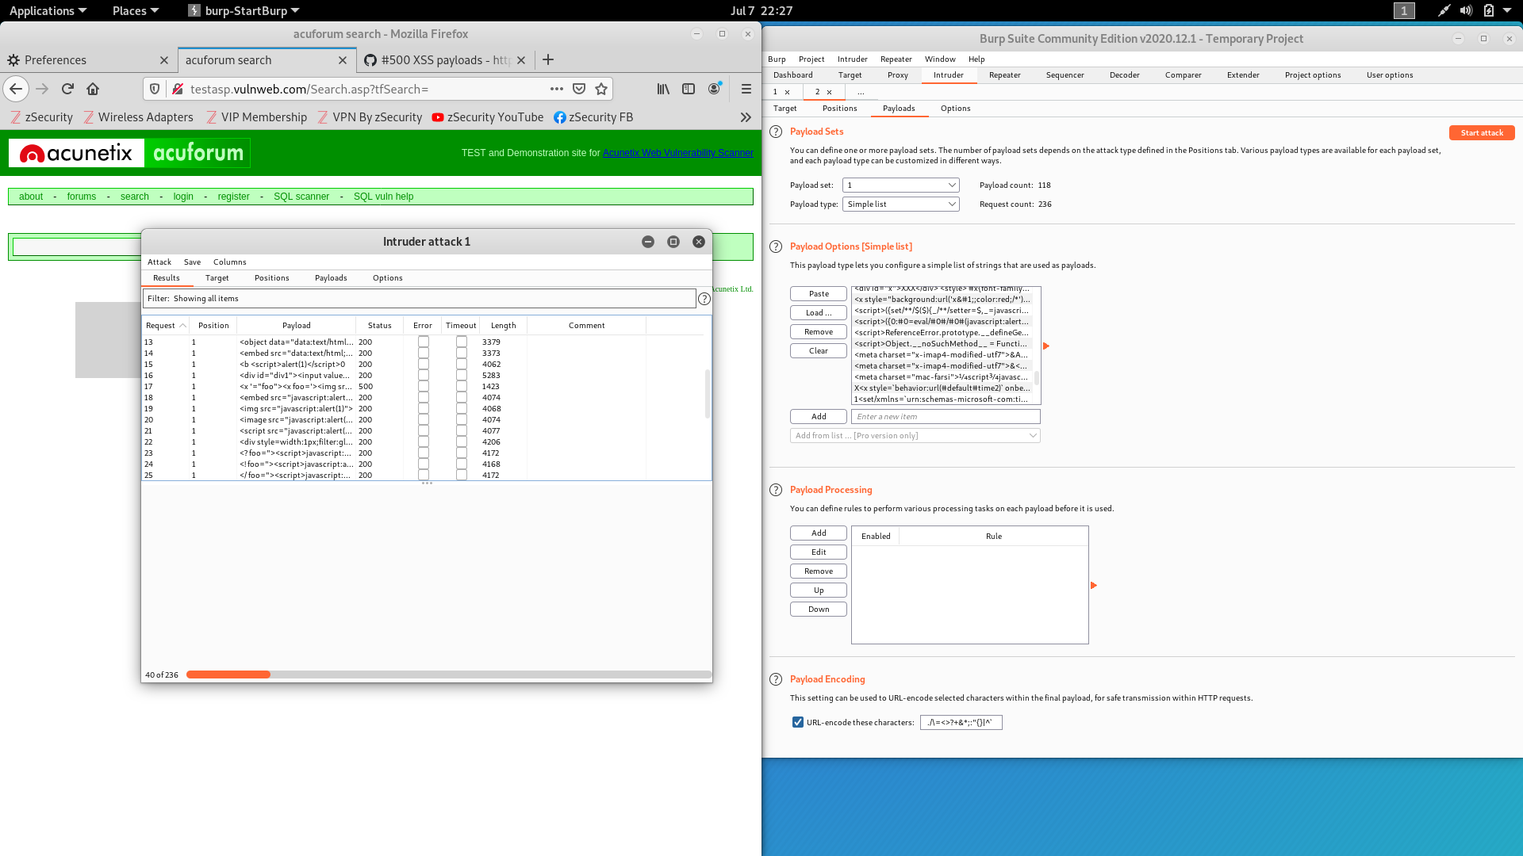
SCREEN SHOTS

Slide 5
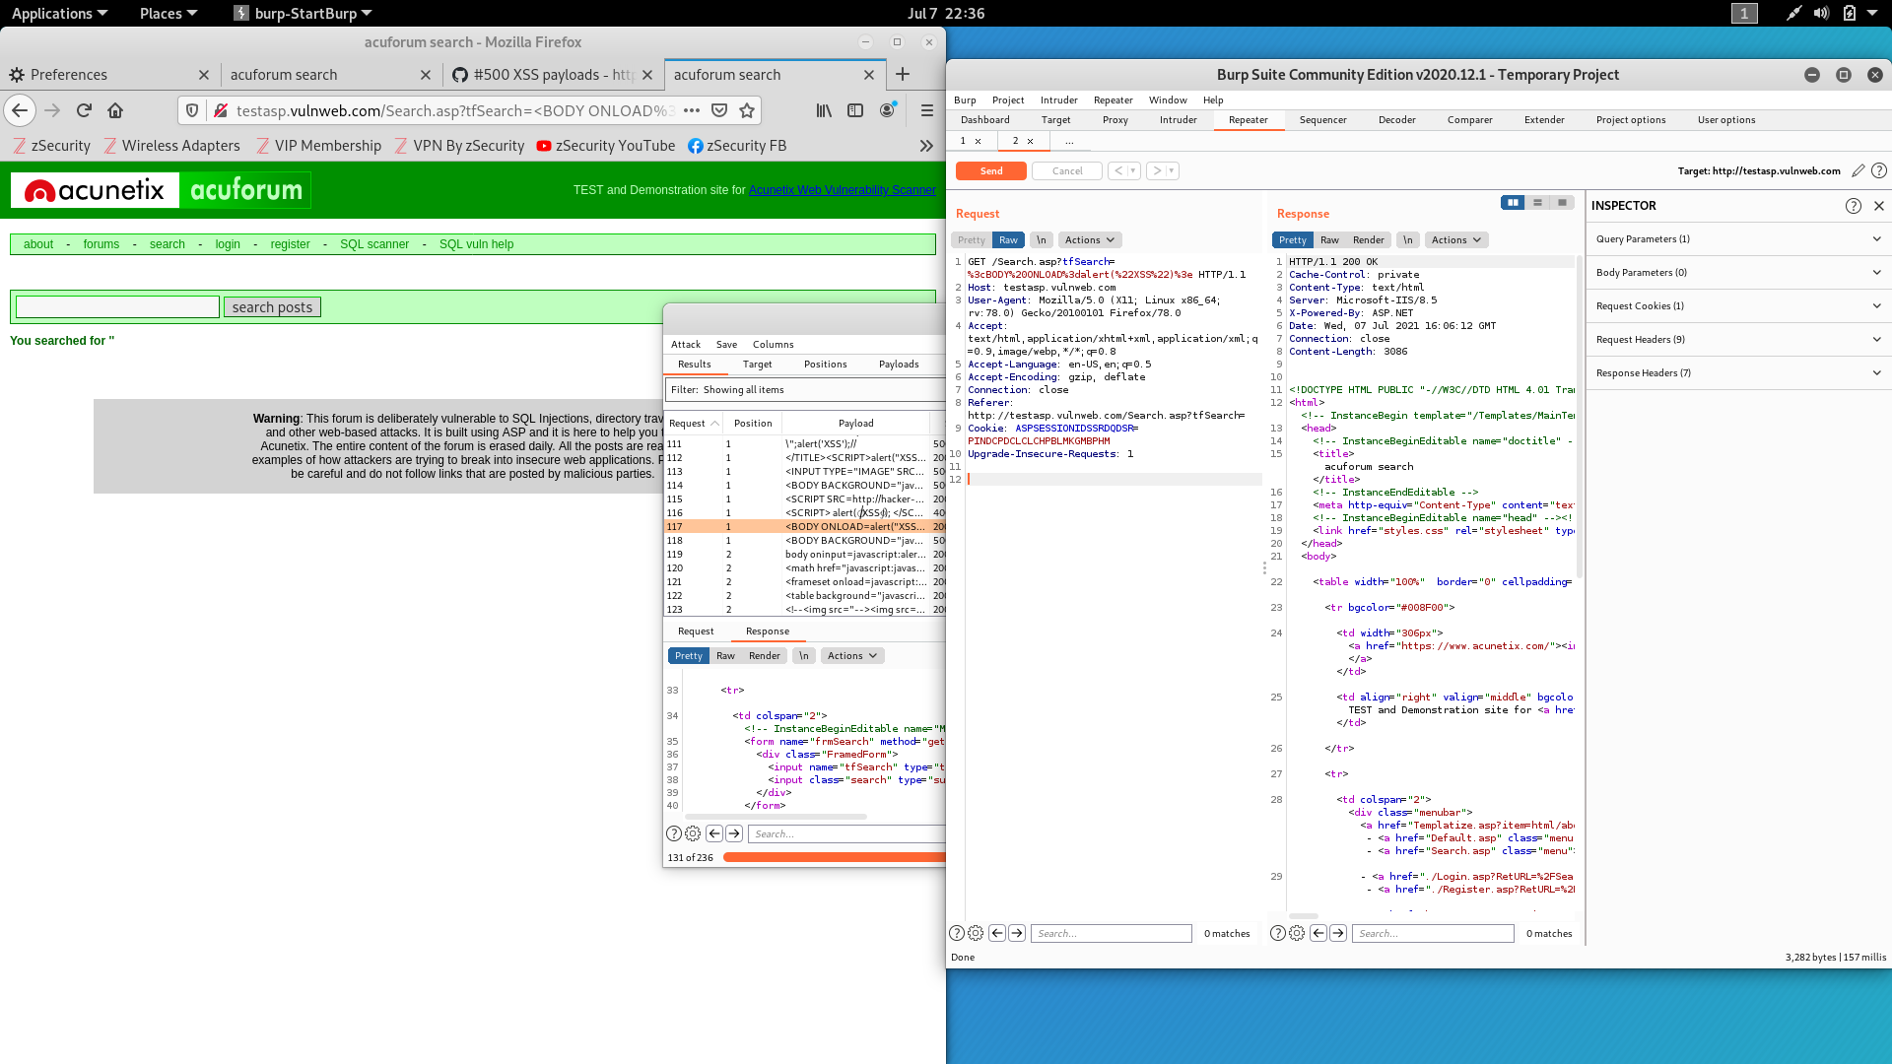

Slide 6
